Slide 1
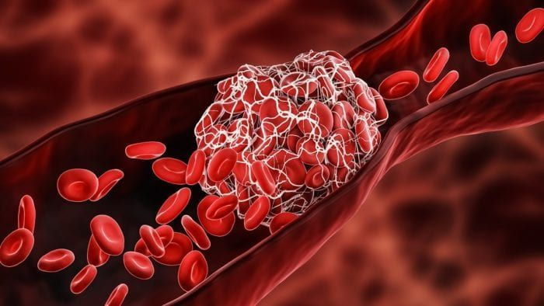

BACHELOR OF TECHNOLOGY IN COMPUTER SCIENCE AND ENGINEERING
Submitted by :
Team ID : LTVIP2026TMIDS87105 Team Size : 4 Team Leader : Kagitala Saikumar Team member : Doddaka Venkata Chandu Team member : Ravi Lakshmi Sai Varun Team member : Kambala Venkata Sai Prem Chand

Slide 2
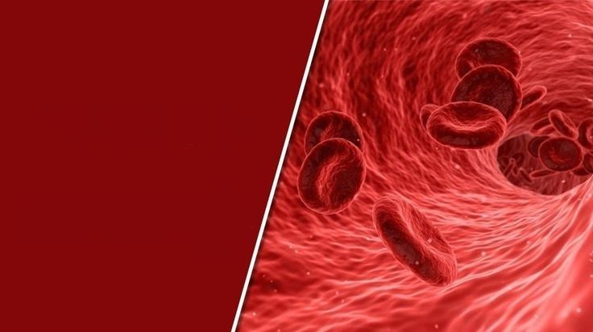
TITTLE:
HematoVision:
Advanced Blood Cell
Classification Using
Transfer Learning
An intelligent deep learning system for automated blood cell classification using transfer learning and CNNs.

Slide 3
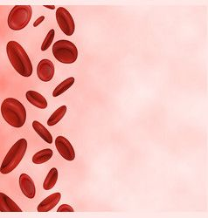
Table of Contents
Introduction
Scope & Motivation
Problem Statement
Proposed Solution
Architecture
Web Application
Technologies Used
Transfer Learning Concept
Data Preprocessing
Applications
Advantages
Conclusion
References

Slide 4

Hematovision is an AI-based project focused on advanced blood cell classification using transfer learning to detect, classify, and analyze white blood cell (WBC) subtypes. Developed as part of an AI/ML internship initiative in collaboration with Smart Bridge/APSCHE, this project automates the identification of blood cells to support rapid, accurate medical diagnostics.

Slide 5

Scope & Motivation:
Scope:-
Manual blood cell classification is time-consuming and requires skilled pathologists, which may lead to delays and human error
Automatically classifies blood cells using deep learning
Identifies four types of blood cells accurately
Can be used in healthcare and medical training systems
Motivation:-
The motivation behind HematoVision is to automate this process using deep learning, thereby reducing workload, increasing accuracy, and enabling faster diagnosis.
Manual blood analysis takes more time
Human errors can occur during diagnosis
thereby reducing workload, increasing accuracy, and enabling faster diagnosis.
The project also aims to support remote healthcare services and educational platforms

Slide 6
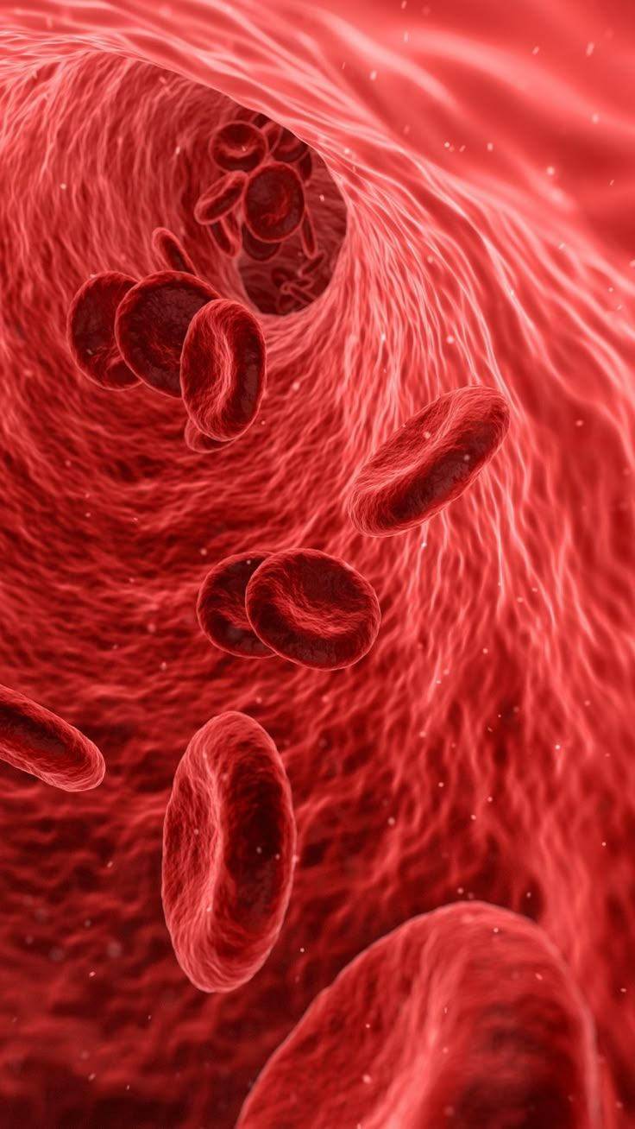
Problem Statement
Traditional blood cell analysis requires expert pathologists
Manual classification is slow and subjective
High computational cost when training deep models from scratch
Need for an accurate, fast, and scalable automated system

Slide 7
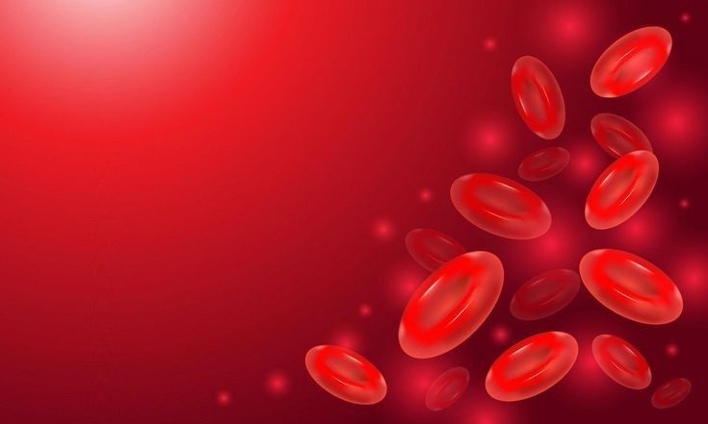
Proposed Solution:
Uses Transfer Learning with pre-trained CNN models
Classifies blood cells into:
Eosinophils
Lymphocytes
Monocytes
Neutrophils
Reduces training time and computational cost
Achieves high classification accuracy

Slide 8
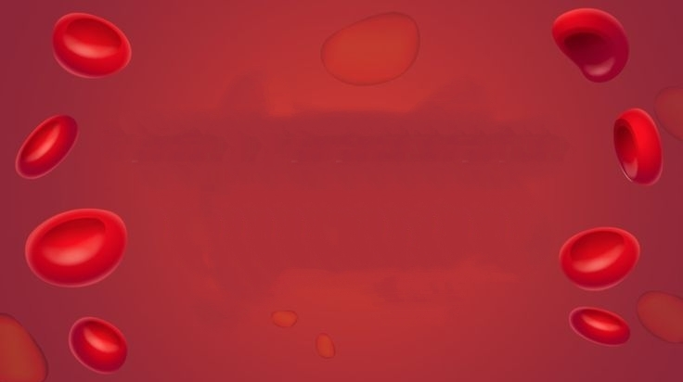
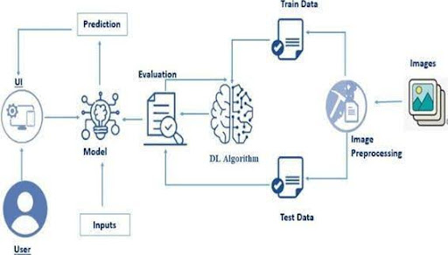
Architecture:
1.Blood cell images are first collected and passed through image preprocessing . 2.The processed images are split into training and testing datasets. 3.A transfer learning–based deep learning model pretrained CNN extracts features and learns to classify blood cell types. 4.The model is evaluated using test data to measure performance and accuracy. 5.The trained model is integrated with a user interface to provide final prediction results.

Slide 9

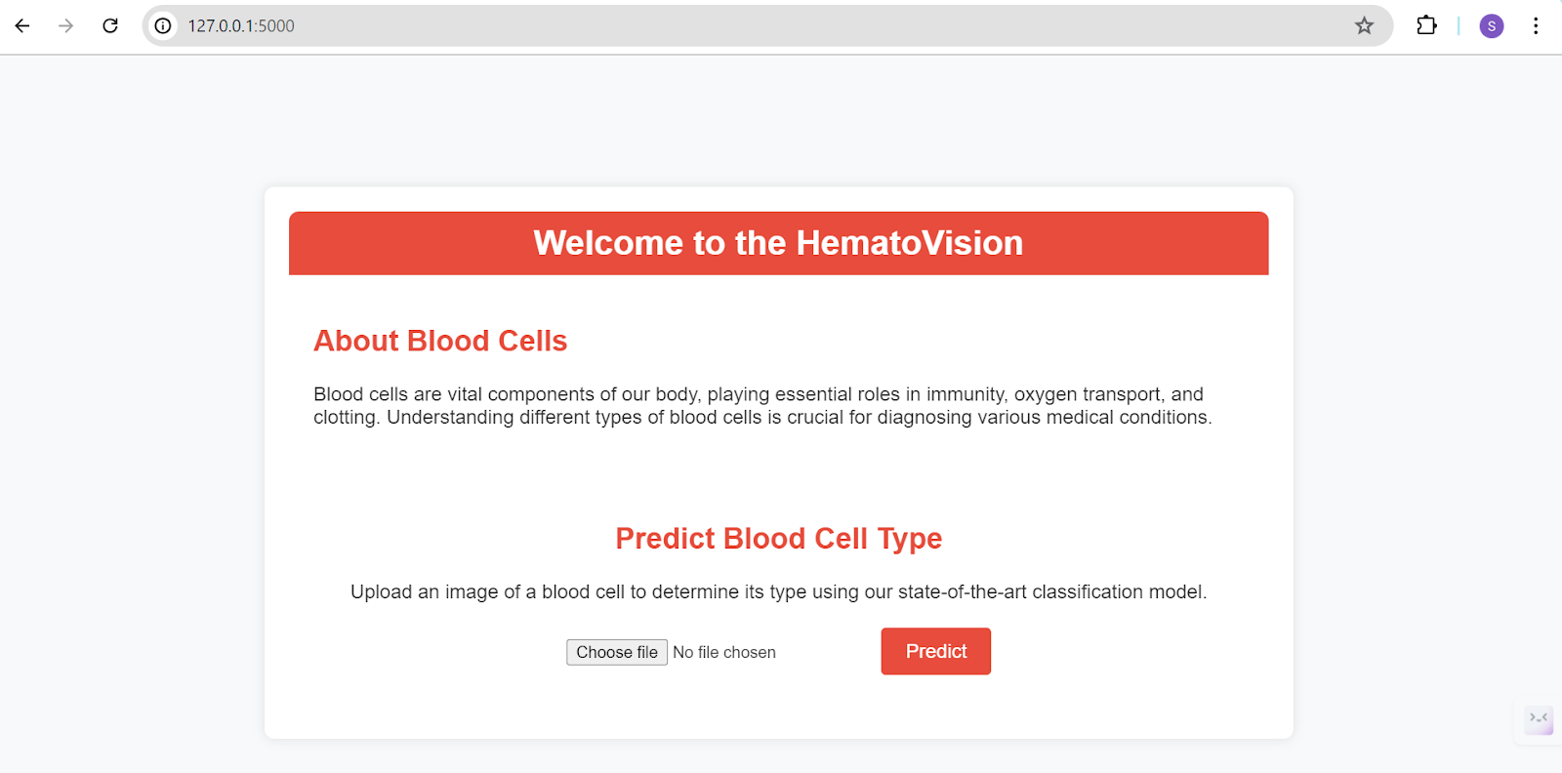
Web Application:
Building HTML Pages:
For this project create Two HTML files namely
home.html
result.html
Build Python code:
App.py
Let’s see what our index.html page looks like:

Slide 10
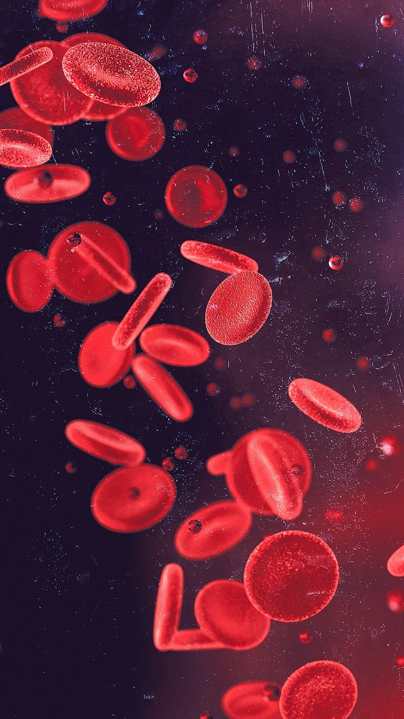

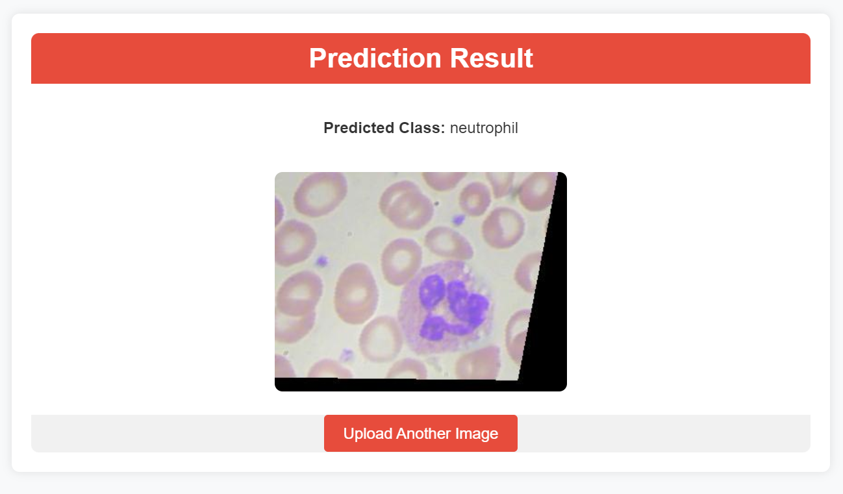
Test For Class-1 : Neutrophil
By clicking on choose file it will ask us to upload the image , then by clicking on the predict button , it will take us to the result.html
Neutrophils are white blood cells that form the first line of defense against infections by destroying bacteria and foreign particles.

Slide 11
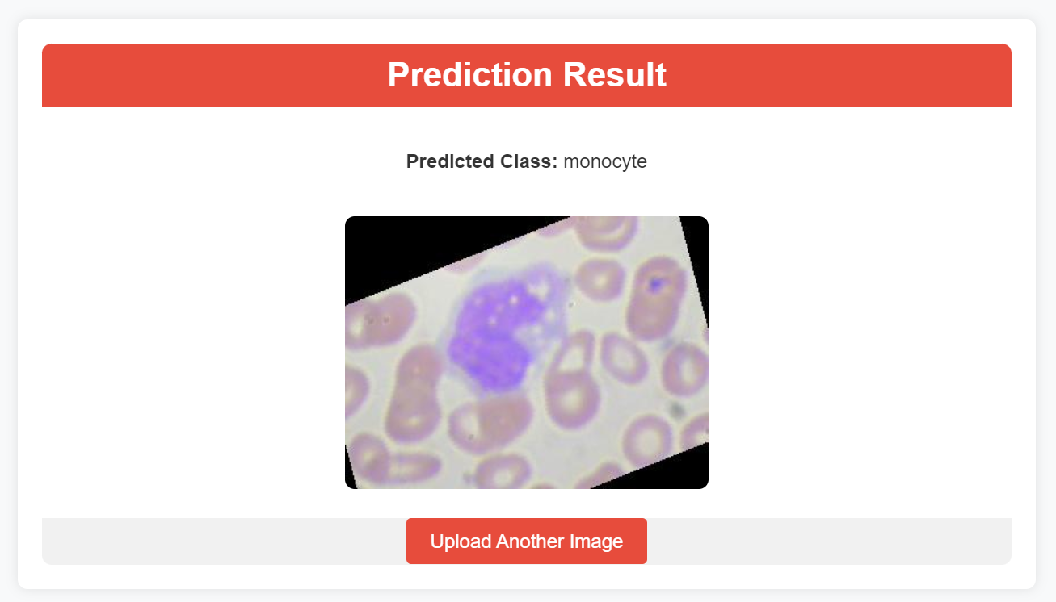
Test For Class-2 : Monocyte
By clicking on choose file it will ask us to upload the image , then by clicking on the predict button , it will take us to the result.html
Monocytes are white blood cells that help fight infections by ingesting pathogens and developing into macrophages or dendritic cells in tissues.

Slide 12
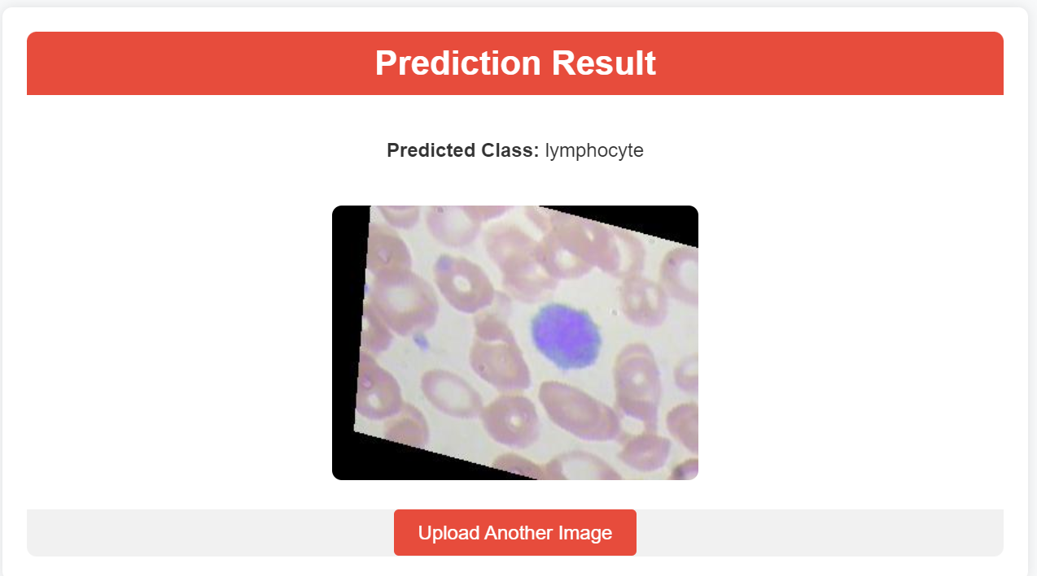
Test For Class-3 : Lymphocyte
By clicking on choose file it will ask us to upload the image , then by clicking on the predict button , it will take us to the result.html
Lymphocytes are white blood cells responsible for adaptive immunity, producing antibodies and coordinating immune responses against infections.

Slide 13
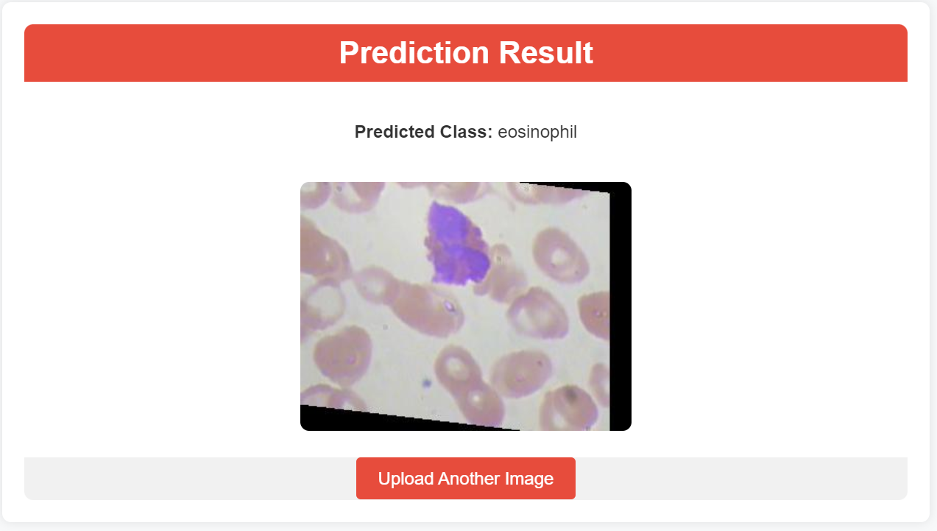
Test For Class-4 : Eosinophil
By clicking on choose file it will ask us to upload the image , then by clicking on the predict button , it will take us to the result.html
Eosinophils are white blood cells involved in combating parasitic infections and playing a role in allergic and inflammatory responses.

Slide 14
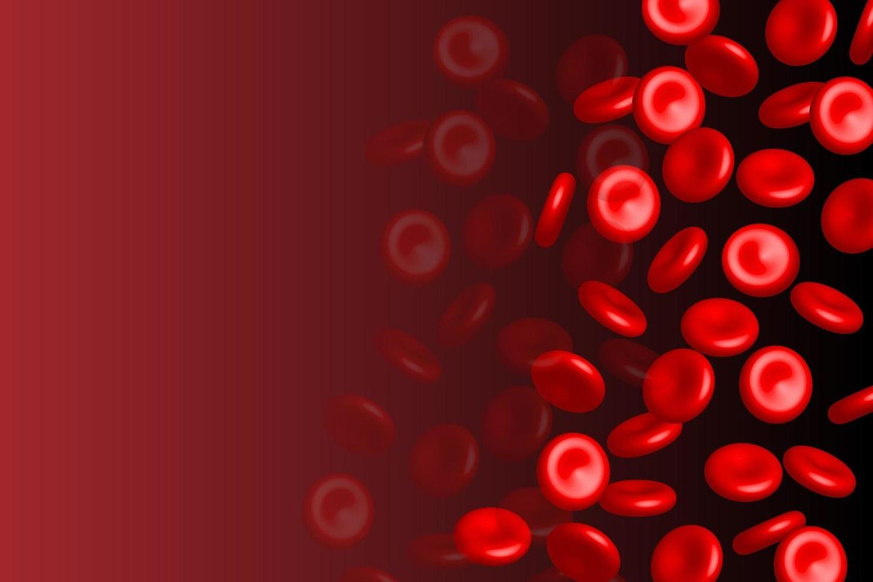
Technologies Used:
HTML for frontend design
Python for backend design
TensorFlow and Keras for deep learning
MobileNetV2 for transfer learning
Flask for web application development
Anaconda Navigator for environment management

Slide 15
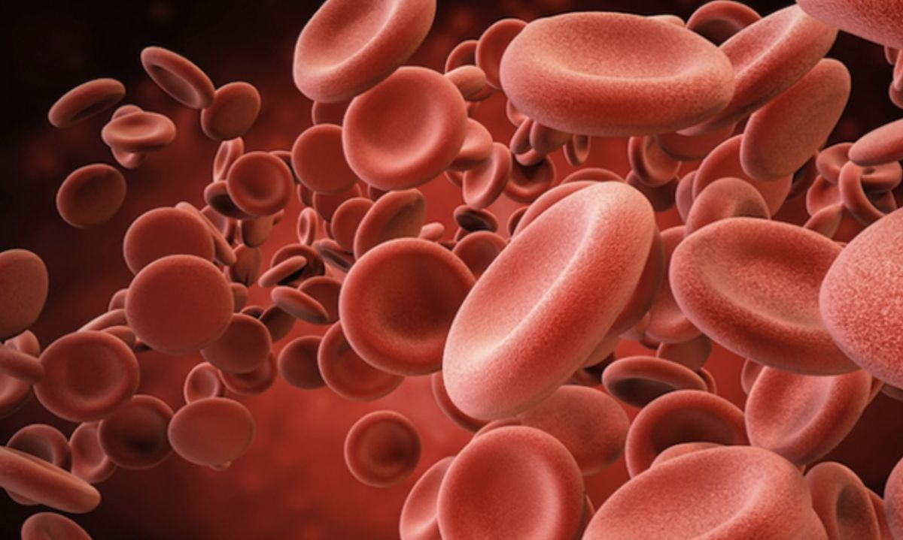
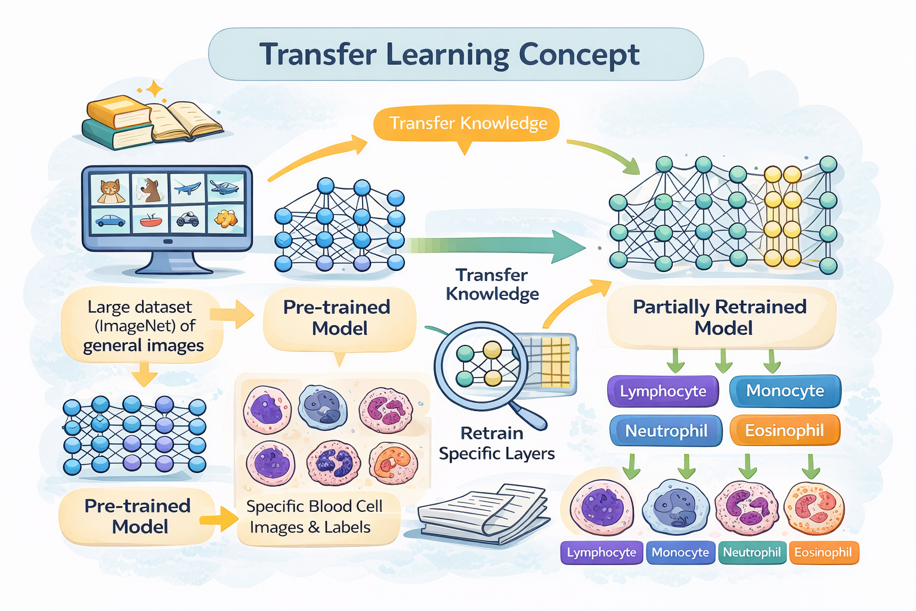
Transfer Learning Concept:
Transfer learning enables the use of pre-trained CNN models that have already learned important image features from large datasets. In HematoVision, a pre-trained MobileNetV2 model is used, and only the final layers are fine-tuned for blood cell classification.

Slide 16
Key Performance Benefits:
Data Efficiency
Speed & Accuracy
Multimodal Integration
Typical Workflow:
Preprocessing
Architecture Setup
Optimization

Slide 17
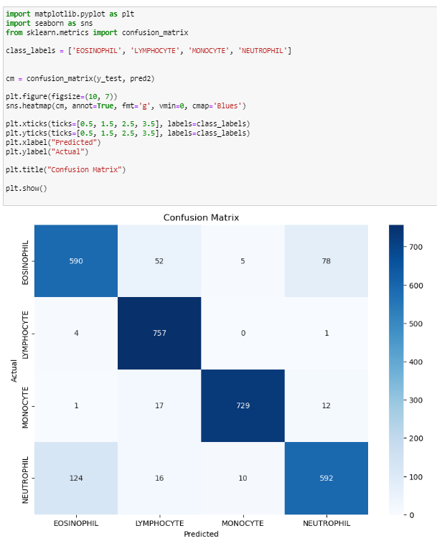
Data Preprocessing:
Data preprocessing involves resizing and normalizing blood cell images to match the model’s input requirements. The dataset is already augmented and divided into training and testing sets. Label encoding is applied to classify images into four categories: eosinophils, lymphocytes, monocytes, and neutrophils.
Testing Model & Data Prediction:

Slide 18
Applications:
Scenario 1: Healthcare Automation
Real-time blood cell analysis
Reduces workload on pathologists
Faster and accurate diagnosis
Scenario 2: Telemedicine
Remote blood sample analysis
Useful for rural and underserved areas
Scenario 3: Medical Education
Interactive learning for students
Hands-on experience in cell classification

Slide 19
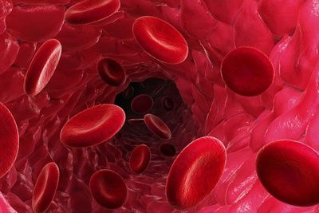
Advantages:
High accuracy
Reduced training time
Low computational cost
Scalable and reliable
Enables faster and more accurate blood cell diagnosis in hospitals
Cost-effective due to reduced equipment and labor dependency
Useful in rural and underserved areas with limited specialists
Minimizes human error in microscopic blood analysis

Slide 20
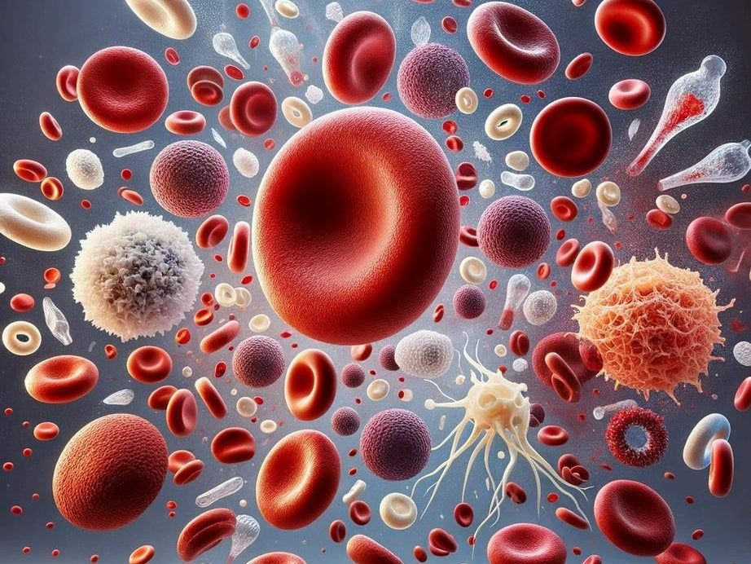
Conclusion
HematoVision successfully demonstrates the use of transfer learning for automated blood cell classification. By combining deep learning and web-based deployment, the system provides an accurate, efficient, and scalable solution for medical diagnostics. The project highlights the potential of AI-driven tools in improving healthcare services.

Slide 21
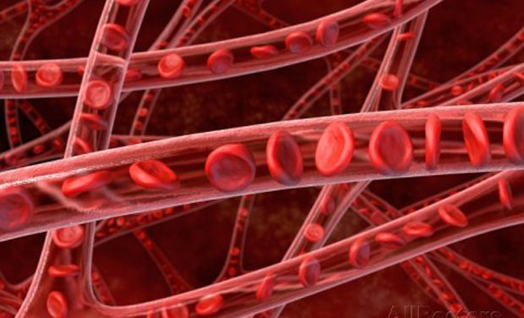
References:
DL Concepts
Neural Networks:: https://www.analyticsvidhya.com/blog/2020/02/cnn-vs-rnn-vs-mlp-analyzing-3-types-of-neural-networks-in-deep-learning/
Deep Learning Frameworks:: https://www.knowledgehut.com/blog/data-science/pytorch-vs-tensorflow
Transfer Learning: https://towardsdatascience.com/a-demonstration-of-transfer-learning-of-vgg-convolutional-neural-network-pre-trained-model-with-c9f5b8b1ab0a
VGG16: https://www.geeksforgeeks.org/vgg-16-cnn-model/
Convolutional Neural Networks (CNNs): https://www.analyticsvidhya.com/blog/2021/05/convolutional-neural-networks-cnn/ s://www.javatpoint.com/k-nearest-neighbor-algorithm-for-machine-learning
Overfitting and Regularization: https://www.analyticsvidhya.com/blog/2021/07/prevent-overfitting-using-regularization-techniques/
Optimizers: https://www.analyticsvidhya.com/blog/2021/10/a-comprehensive-guide-on-deep-learning-optimizers/
Flask Basics: https://www.youtube.com/watch?v=lj4I_CvBnt0

Slide 22
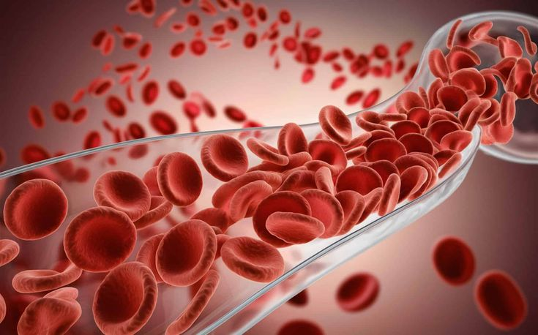
Thank You
Thank you for this opportunity!
Thank you for your time and attention.”
.

